Slide 1
3D House
(Exterior) Design

Slide 2
Presented By
Joy Pal – 201002418
Jakir Hossain - 201002050
Group - 13

Slide 3
Exterior Design
Consistent with your surroundings
Reduces the impact on your site's landform
Makes the most of solar access and other natural features.

Slide 4
Objectives
To learn the high level architecture design.
To learn the various tools of AutoCAD software.

Slide 5
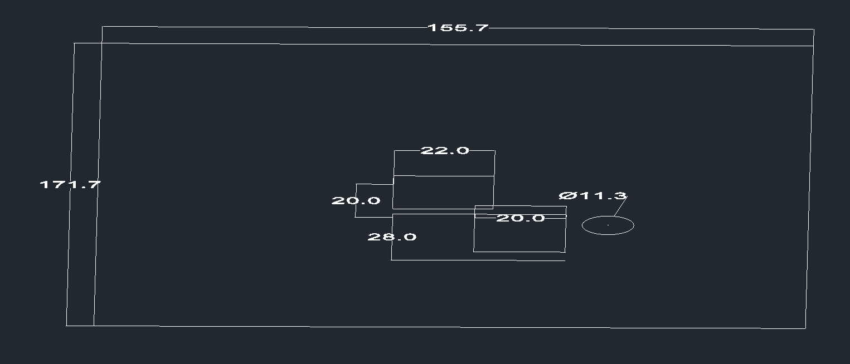
Specify & Draw the Line

Slide 6
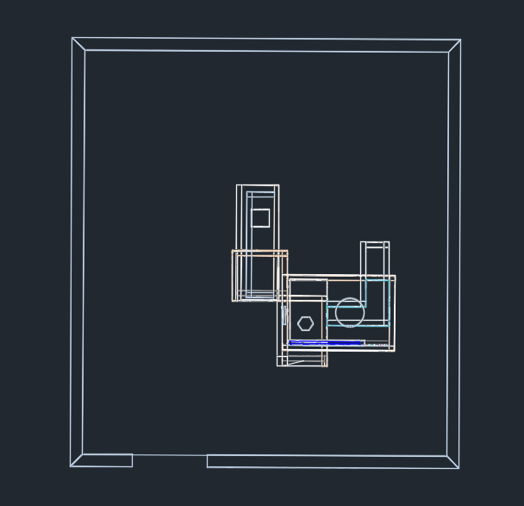
Implement

Slide 7
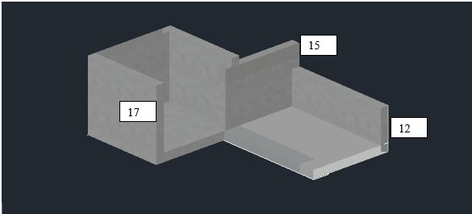
Implement

Slide 8
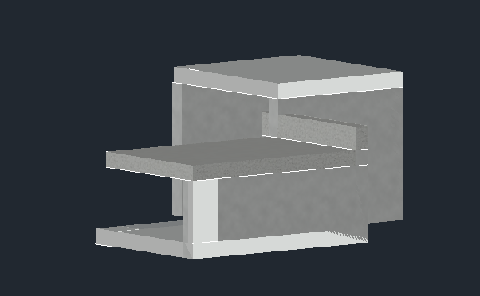
Implement

Slide 9
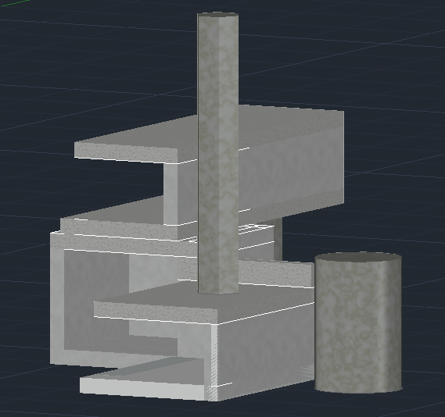
Implement

Slide 10
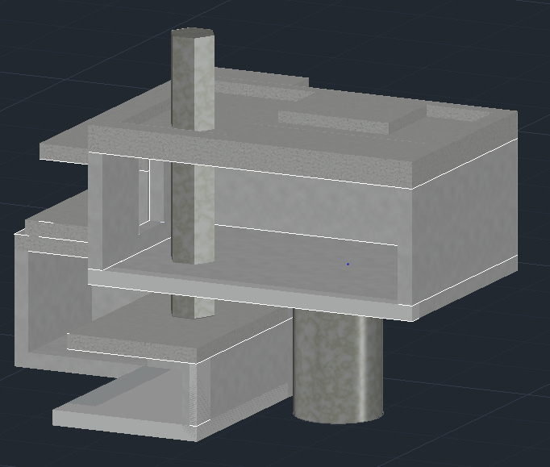
Implement

Slide 11
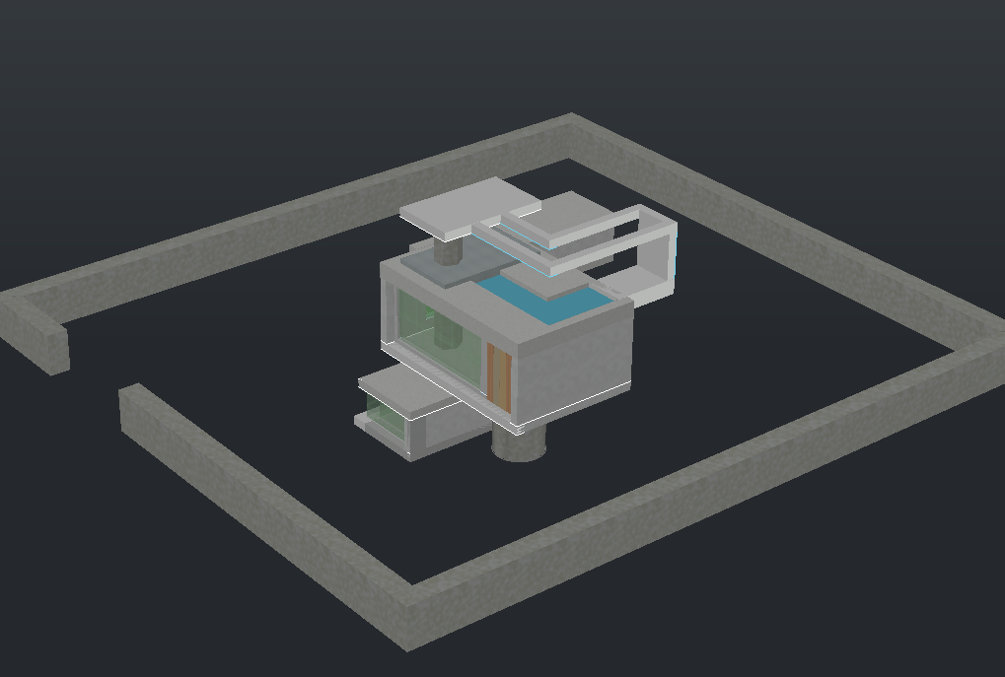
Implement

Slide 12
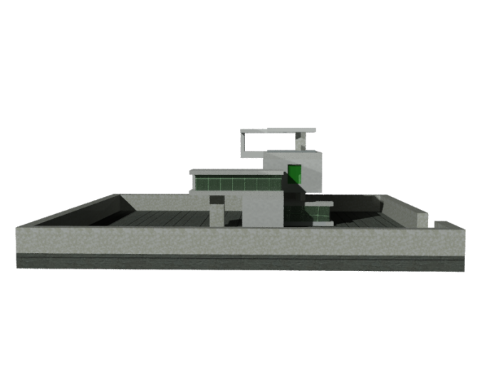
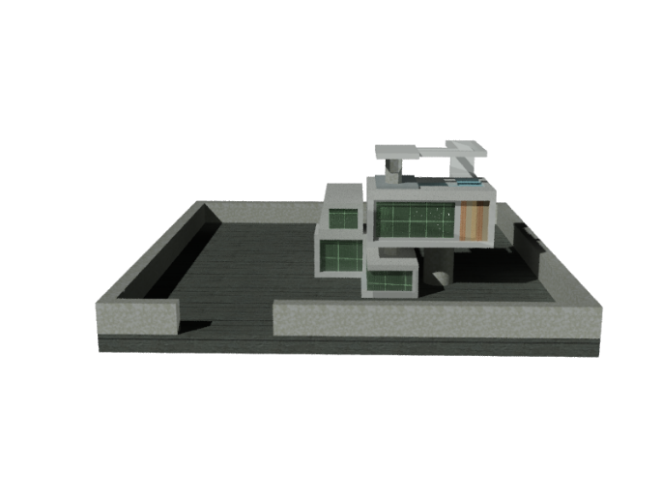
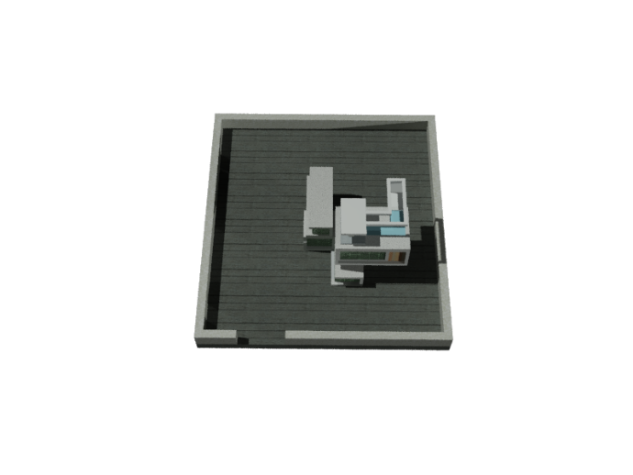
Realistic View

Slide 13
Thank You…

